Slide 1
RESTful Web Service using Docker & Spring Boot
-Rushda mansuri

Slide 2
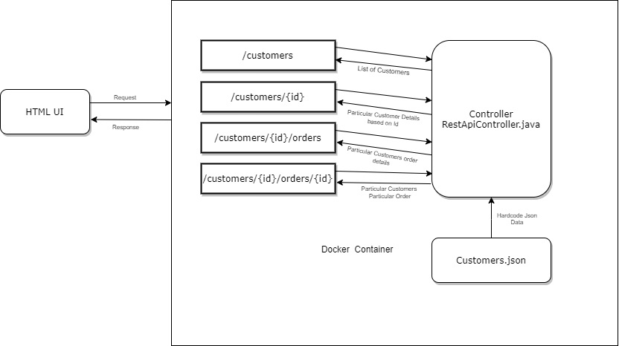
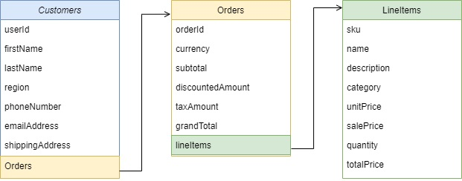
Json File Structure

